Slide 1

On block-boc
Konstantinos Andreou

Slide 2
They say we are in digital age
Are we? - Real-Estates ownership still on paper. - Money printed on paper.

Slide 3

BlockchaiN
We need a technology that:
1. Transparent
2. Transaction processes in seconds
3. Secure
4. And entirely digital
NO CONTROL?

Slide 4

Smart Contracts:
In simple words: We build on existing blockchain ecosystem, our “Code”. We decide the functionalities! We get Control!
EurBoC – Euro on blockchain Fiat Pegged
Real-Estates - NFT
and Real-Estate-Marketplace
Verify wallets on blockchain
Have Control

Slide 5

DEMo

Slide 6
Why Should the Bank Care?
Automated Transactions: Reduce employee hours and operational costs.
EU Blockchain Push (€500m+ for research)
Attract Million of new customers from whole Europe.
Crypto Regulation by 2025:
The EU mandates all member states to regulate crypto by 2025.
(Source: ECB speech on crypto regulation by 2025)
Cyprus Sets the Clock for Crypto: October 30 2025
( Source: Financemagnates )

Slide 7
Billion euro opportunity knocking our door
Global Leaders Moving Forward:
U.S.: Two successful stablecoins (usdt, usdc) already in use. – Worth Billions$
China: Launched its own cryptocurrency, e-CNY.
Digitalization is coming!
Final Question: Are we gonna lead the way or miss Billion-euro opportunity?

Slide 8
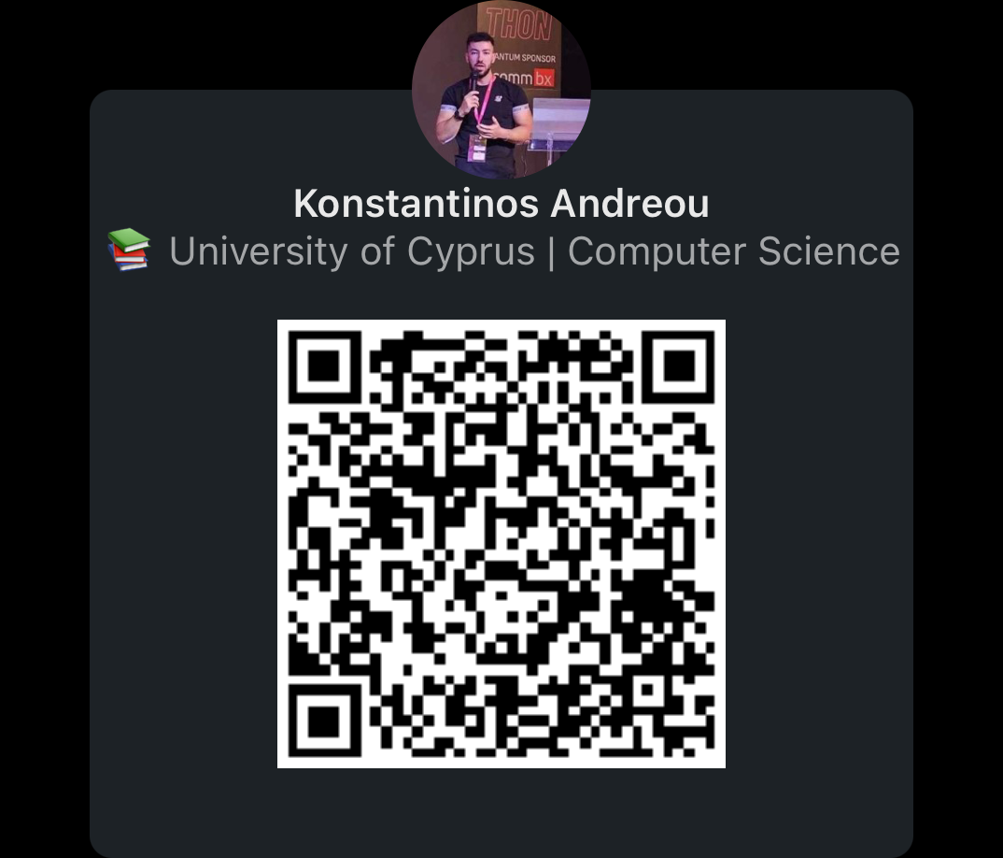
THANK YOU
LinkedIn: @andreou00

